Slide 1
Click through and Scroll through Storytelling
The art of story transition for photo galleries and step graphics

Slide 2
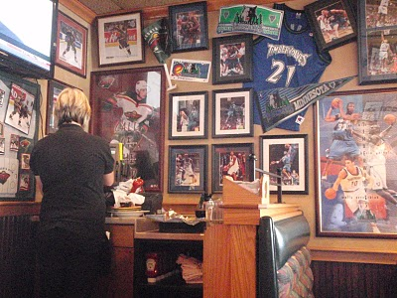
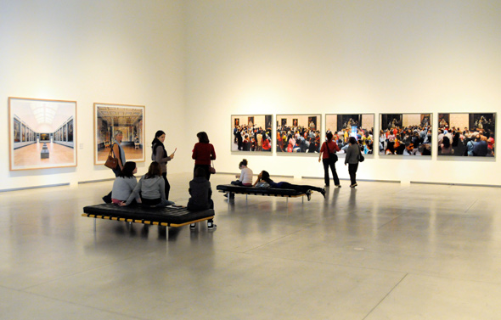
Applebee’s or Art Gallery

Slide 3
Design and Content
Good presentation and user interface design should complement the content
Easy Navigation (Thumbnails, Numbers, Arrows???)
Choice
Should the user be able to jump to any photo or
Should the user only be able to go in order

Slide 4
Core Components
Visual
Color
Graphics/Photos
Overall Presentation and User Experience
Content
Purpose or Point
Story/Knowledge
Beginning, Middle or End
Explain a Process or Event

Slide 5
Schemes for Visual Editing Slideshows
Story Arc (Ideal)
Chronological
Tonal

Slide 6
Simplified Visual Story Arc
Character Introduction
Conflict
Resolution

Slide 7
Great editors share emotion
Don’t show doing pictures
Show me how people feel about what they are doing.

Slide 8
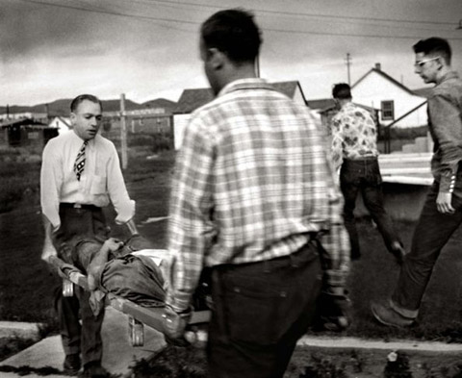

Slide 9
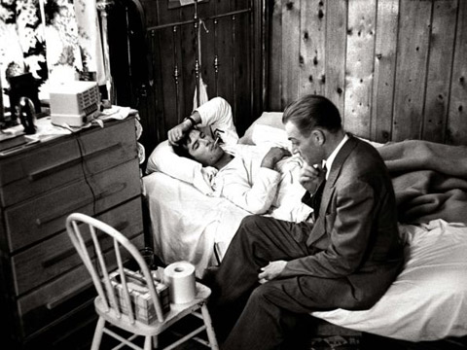

Slide 10
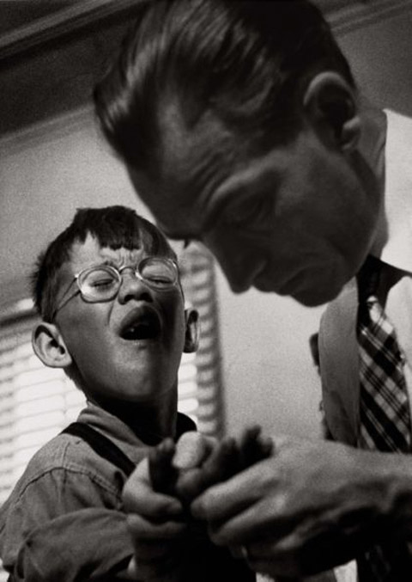

Slide 11
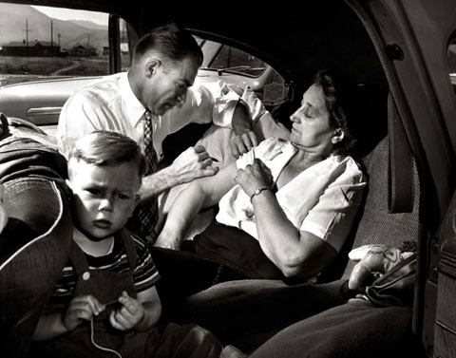

Slide 12
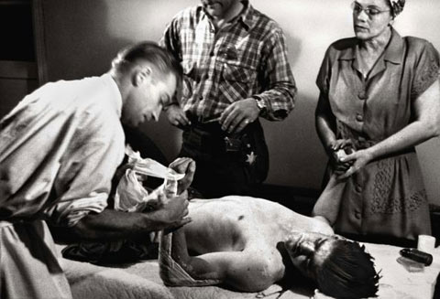

Slide 13
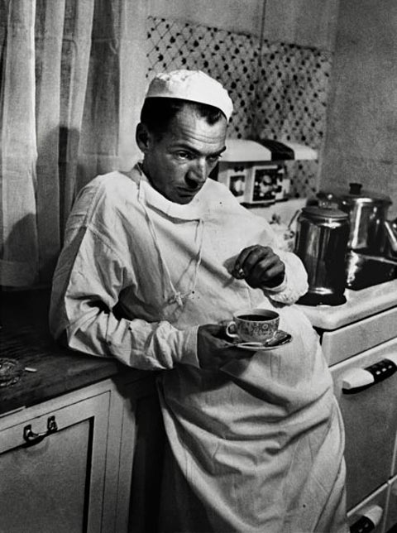

Slide 14
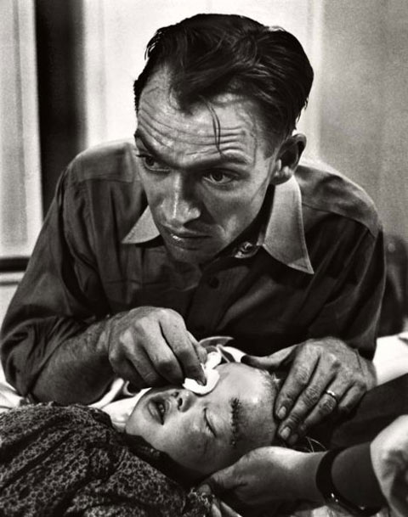

Slide 15
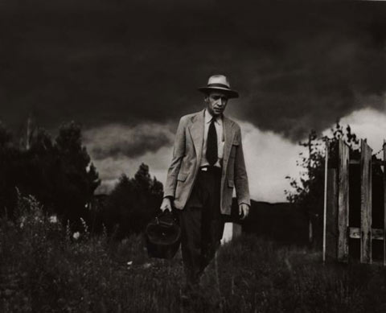

Slide 16
Examples
http://lens.blogs.nytimes.com/2013/01/28/women-shooting-on-the-front-lines-2/

Slide 17
Thomas Cole’s Voyage of Life
The Voyage of Life series, painted by Thomas Cole in 1842, is a series of paintings that represent an allegory of the four stages of human life: childhood, youth, manhood, and old age. The paintings follow a voyager who travels in a boat on a river through the mid-19th century American wilderness. In each painting, accompanied by a guardian angel, the voyager rides the boat on the River of Life. The landscape, corresponding to the seasons of the year, plays a major role in telling the story. In each picture, the boat's direction of travel is reversed from the previous picture.

Slide 18
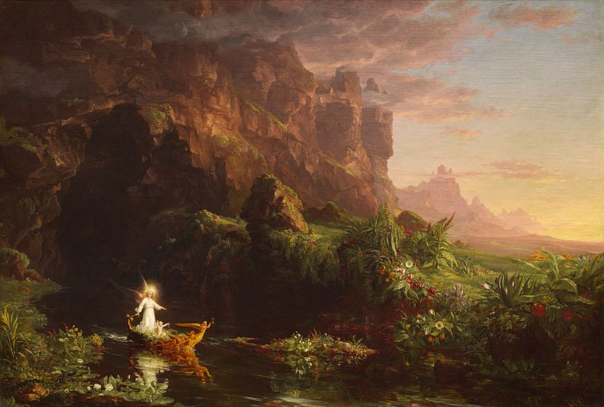

Slide 19
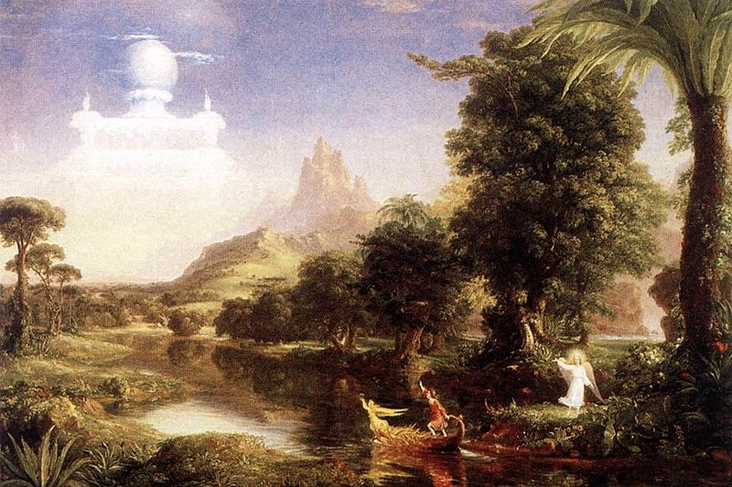

Slide 20
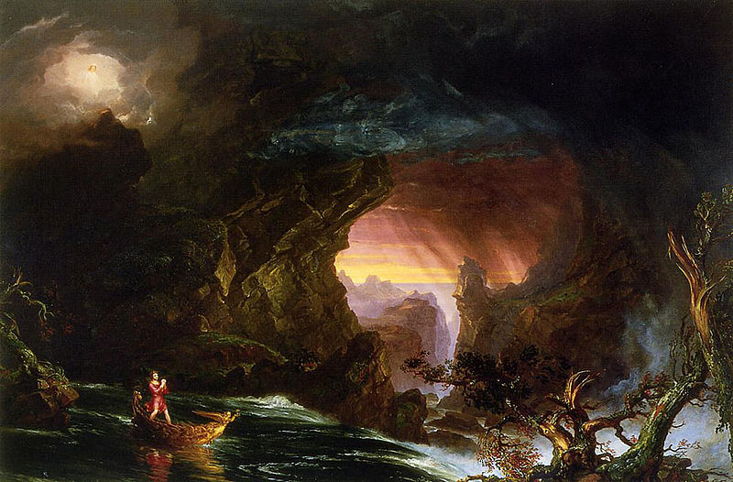

Slide 21
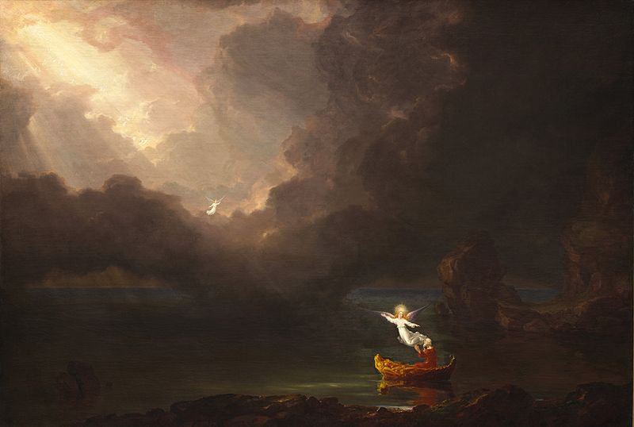

Slide 22
Stepper or Scrolling Graphics
Explain something in less than 10 steps
Teach me ONE overall concept an one “cool” tidbit.
Best when accompanied by context (Article)
https://www.nytimes.com/interactive/2016/07/14/world/europe/trail-of-terror-france.html
https://www.nytimes.com/interactive/2016/08/02/business/dealbook/this-is-your-life-private-equity.html

Slide 23
How to make one
https://venngage.com/blog/how-to-make-an-infographic-in-5-steps/

Slide 24
Core Components
Good Design and easy User Experience
Simple and involving visuals
Good data and information
Progression
Time
Location
Experience
Knowledge

Slide 25
jQuery Plugins
Slider Graphics
Notes:
don’t use: JSSOR
look for true plugin — BX Slider
make sure it’s responsive
look in GitHub
upload plugins GitHub

